Slide 1

Preliminaries
Distribution
Forms & functions
Wrap-up
References
Extra slides
On the rise of applicatives in West Nusantara languages
Christina L. Truong University of Hawai‘i at Mānoa cltruong@hawaii.edu
16th International Conference on Austronesian Linguistics
De La Salle University, Manila, Philippines
June 20–24, 2024

Slide 2
Preliminaries
Distribution
Forms & functions
Wrap-up
References
Extra slides
Introduction
This study examines the distribution of applicative constructions (ACs) in Malayo-Polynesian languages of West Nusantara
Considers the relationships between applicatives and geographic location, genetic aﬀiliation, and other typological features of language
Part of a larger dissertation research project (Truong 2024)
(1) An applicative construction is a kind of clausal construction in which overt morphological marking* on the verbal complex coincides with the selection of a non-agent, non-patient semantic role to map to a core argument in the clause.
* This overt morphological marking = Applicative morpheme (AM)
Notes:
West Nusantara = Malaysia, Singapore, Brunei and Indonesia, as far east as Sulawesi in the north and Lombok in the south, without respect to national borders.
“Western Indonesian” = too exclusive

Slide 3
Preliminaries
Distribution
Forms & functions
Wrap-up
References
Extra slides
Types of applicatives
In this study, I include two types of constructions:
Philippine-type LV and CV constructions
Function as applicatives (though not a language-specific category ala Haspelmath 2010)
The peripheral role must be the pivot = Pivot-selecting
Examples: Kimaragang, Tatana, Central Sama
Pivot-neutral applicative constructions
Peripheral role is a clausal argument
Co-occur with other voice constructions that determine mapping of role to the pivot (e.g. AV, PV, passive)
Examples: Balinese, Sundanese, Pendau
Notes:
Not a claim that LV and CV are non-basic, not claiming that they are derived forms of PV. Not a claim that LV and CV should be analyzed as a “language specific category” in any given Philippine-type language. Just that they fall under the “comparative concept” of applicative. LV and CV function as applicatives in other language families (Bantu, Uto-Aztecan, Salishan, etc.) in respect to the definition above in (1).
That the peripheral role must exclusively be pivot, most syntactically privileged argument, is typologically unusual. PIVOT = core argument.

Slide 4
Preliminaries
Distribution
Forms & functions
Wrap-up
References
Extra slides
LV and CV in Tatana (Pivot-Selecting)
Tatana, Philippine-type voice alternations
  Naka-bali aku do kana’ sino do pasar.
av.nvol.pst-buy 1sg.nom dat fish there dat market
‘I bought the fish there at the market.’ (AV)
(Dillon 1994: 69)
b. Boli-on ku dudungu’ diti
buy-pv 1sg.gen banana this
‘I am buying these bananas.’ (PV)
(Dillon 1994: 44)
c. Bali-an ku okou do dudungu.
buy-cv 1sg.gen 2sg.nom dat banana
‘I am buying bananas for you.’ (CV)
(Dillon 1994: 52)
d. Kadai diti andang-andang pam-(b)ali-an ku
shop this rdp-usual lv-buy-lv 1sg.gen
‘This shop is where I usually buy things.’ (LV)
(Dillon 1994: 60)
Notes:
Two of these constructions meet the criteria to the be relevant to the comparative concept of applicative, because in two cases, the use of the overt morphology must coincide in the selection of a peripheral semantic role (non-agent, non-patient) as a core argument. Only in this case it must be the pivot. This is unusual, but our definition doesn’t speak to this. Also note that these constructions do not combine with one another, one and only one of these values must be specified for the clause to be grammatical.

Slide 5
Preliminaries
Distribution
Forms & functions
Wrap-up
References
Extra slides
Pivot-neutral applicatives in Balinese
(3) Balinese, Voice alternations
(4) Balinese, Loc. appl. + Voice alternations
a. Buku beli tiang di toko ento.
book pv.buy 1sg at shop dist
a. Toko ento beli-in
tiang buku.
shop dist pv.buy-loc.appl 1sg book
‘I bought the book in that shop.’ (PV, with patient pivot)
b. Tiang m-(b)eli buku di toko ento.
1sg av-buy book at shop dist
‘I bought the book in that shop.’
(AV, with agent pivot) (Artawa 1998: 48)
‘I bought the book in that shop.’ (AC in PV, with location pivot)
b. Tiang m-(b)eli-in toko ento buku.
1sg av-buy-loc.appl shop dist book
‘I bought the book in that shop.’ (AC in AV, with agent pivot)
(Artawa 1998: 55)
Notes:
Zero-marking on the verb = P, the most patient-like argument is pivot.
Nasal prefix on the verb = A, the most agent-like argument is pivot.
In (4), locative applicative suffix –in, which results in the selection of a location or goal as a core clausal argment.
In PV (or separate passive constructions), the location is the pivot. In AV it is not the pivot. On the basis of word order, syntactic behavior.
Pivot-neutral applicative. What most of you think of as applicatives in Western AN languages.

Slide 6
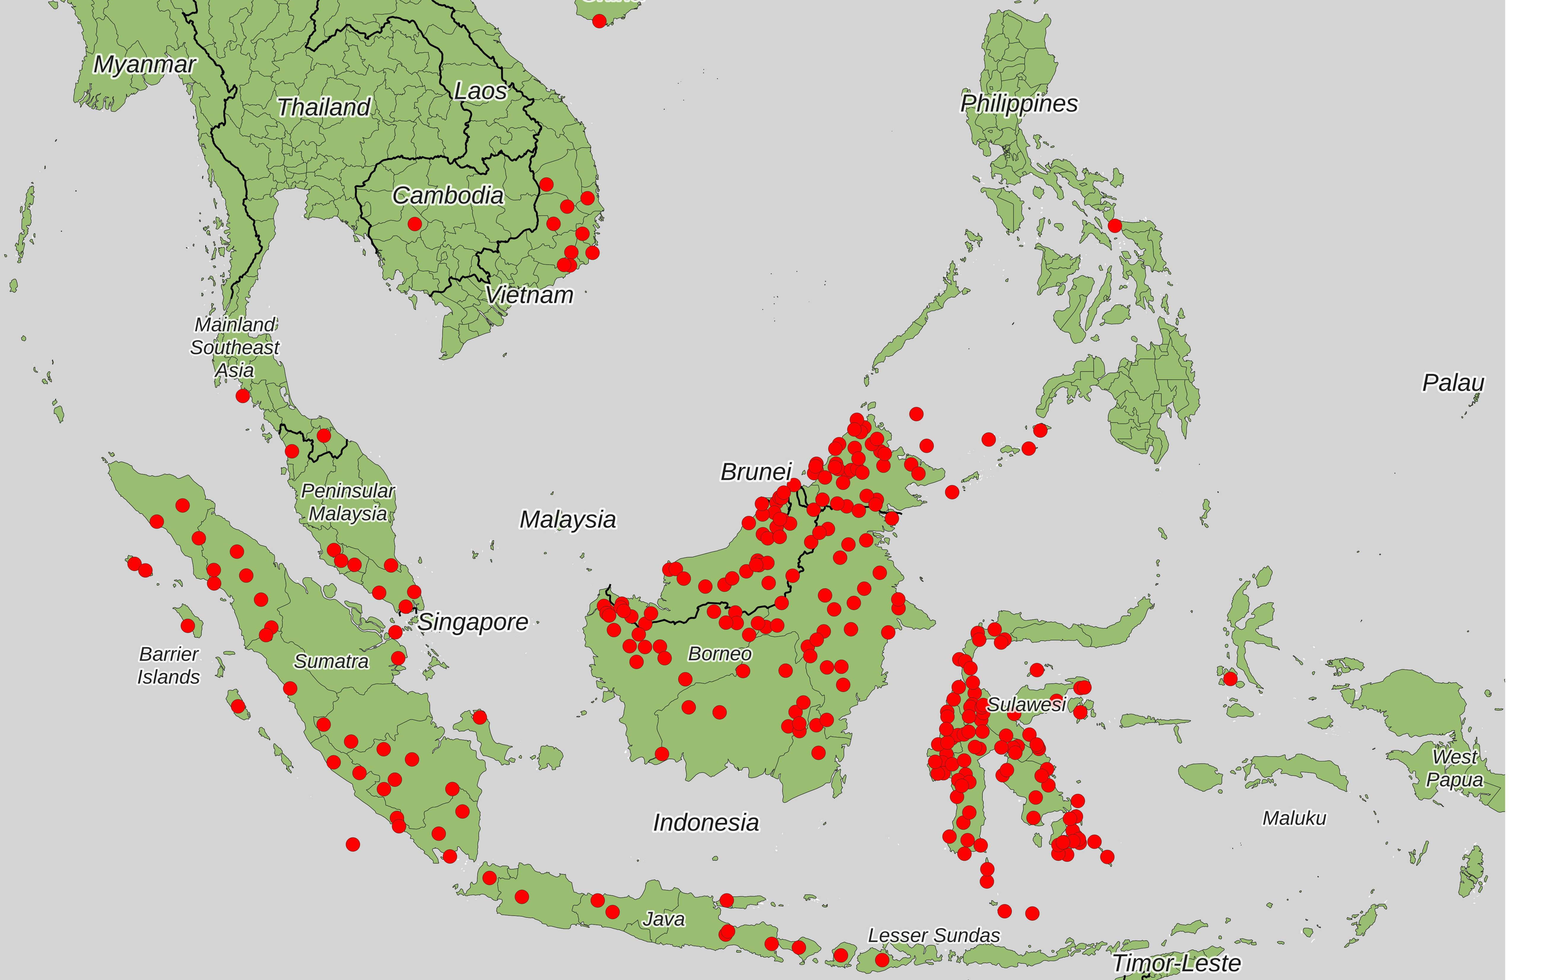
Preliminaries
Distribution
Forms & functions
Wrap-up
References
Extra slides
Austronesian languages originating in West Nusantara (321)
Notes:
Malagasy, New Caledonia Javanese and Suriname Javanese are not in the map here, but they are included in the count (321).

Slide 7
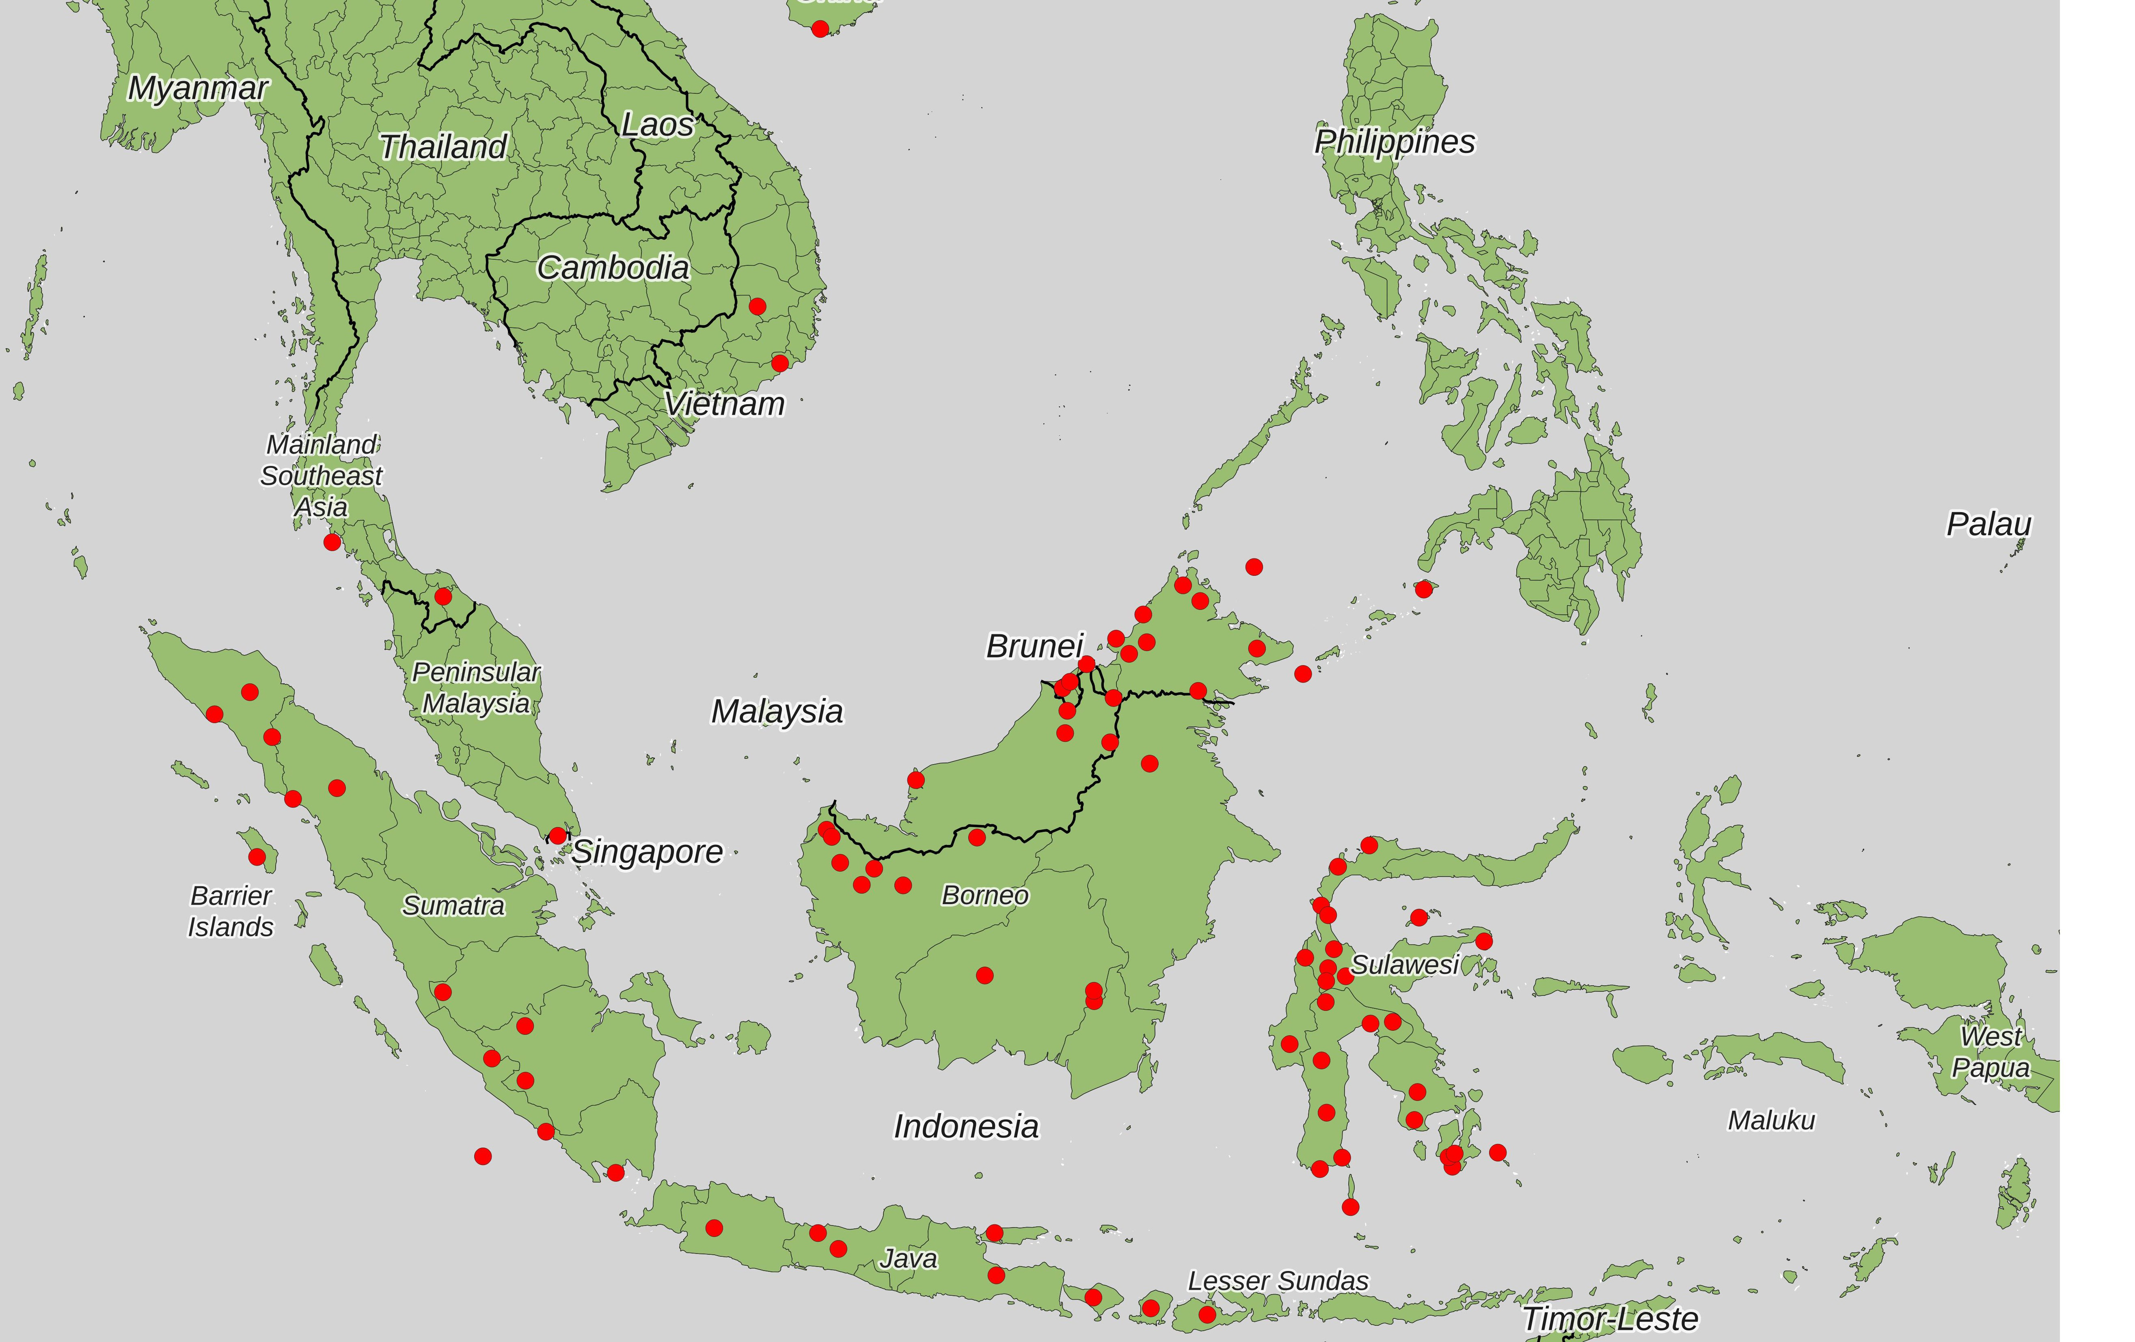
Preliminaries
Distribution
Forms & functions
Wrap-up
References
Extra slides
Language sample (85)
Notes:
85 languages in the sample. All languages with sufficient documentation, descriptive, pedagogical resources such that survey data can be compile. Coded for location. Coded for genetic affiliation according to lower level subgrouping in MP. Coded for the presence of applicatives, type of applicatives, semantic roles selected,

Slide 8
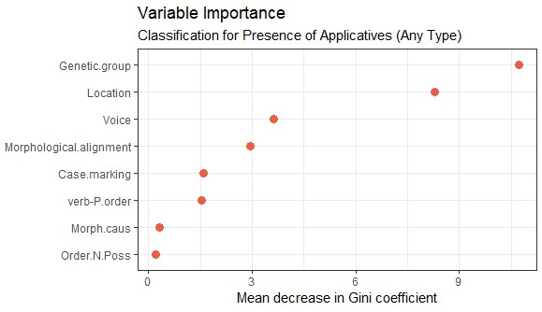
Preliminaries
Distribution
Forms & functions
Wrap-up
References
Extra slides
Random Forest Classification Analysis (see Breiman 2001)
OOB error estimate: 16.46%
Notes:
Coded for typological features of language suggested in the literature to be relevant to applicatives, incl. word order, type of voice system, alignment, case marking, order of N and possessor, presence of morphological causatives. For one part of the statistical analysis, which I won’t emphasize in this presentation, I used a Random Forest classification analysis. Which is a machine learning algorithm, that builds a large number of possible classification trees with splits on the basis of variables. Compares these trees to give a measure of which variables are most useful for sorting or classifying the languages into two groups, those with applicatives and those without.

Slide 9
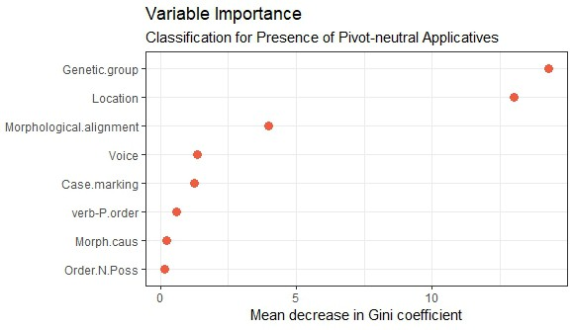
Preliminaries
Distribution
Forms & functions
Wrap-up
References
Extra slides
Random Forest Classification Analysis
OOB error estimate: 18.99%
Notes:
Results are that by far the most useful variables for correctly predicting whether a language has applicatives or not in this set of languages are genetic affiliation and location.

Slide 10
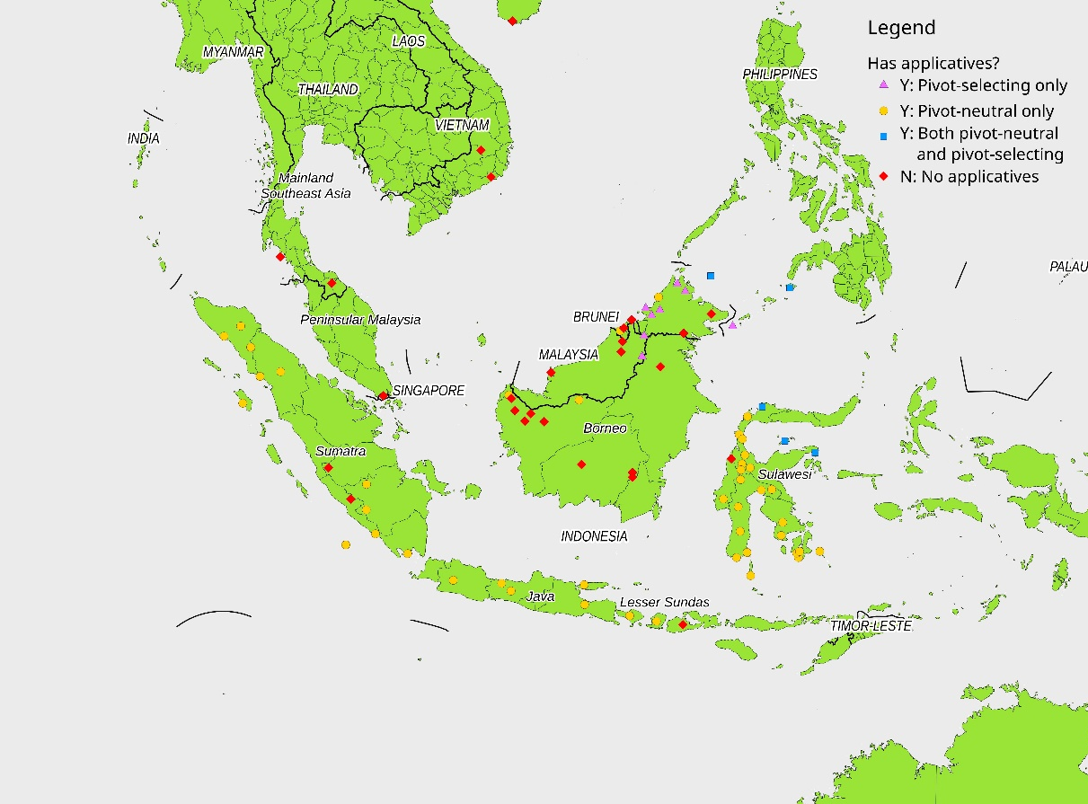
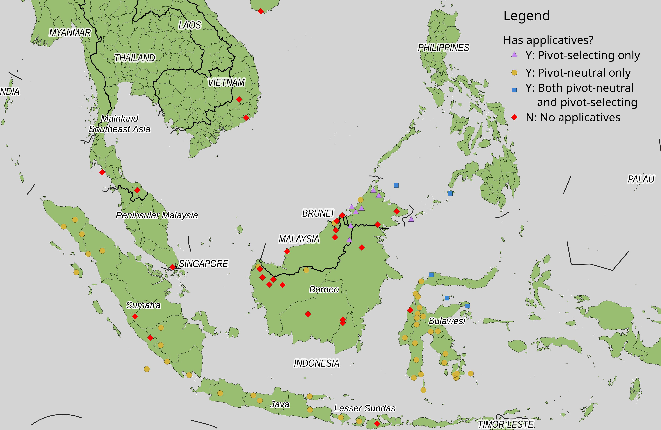
Preliminaries
Distribution
Forms & functions
Wrap-up
References
Extra slides
Geographic distribution

Slide 11
Preliminaries
Distribution
Forms & functions
Wrap-up
References
Extra slides
Findings
Pivot-neutral applicatives are a broadly distributed areal feature
Associated with reduction of the four-way Philippine-type voice system
Found across different symmetrical & asymmetrical voice systems
Philippine-type, in transition (Balantak, Totoli, Central Sama)
two-way symmetrical (Balinese, Pendau)
marginal two-way (Bugis)
asymmetrical (Muna)
Found across patterns of morphological alignment
ergative (Bugis)
accusative (Muna)
mixed, special marking of non-pivot A (Sundanese)
mixed, other (Ampenan Sasak, Jambi)
Found across types of case marking, use of pronominal sets
Not associated with an “Indonesian-type” profile (see Himmelmann 2005)
Notes:
Indonesian-type = typological profile
Himmelmann 2005 “Defining features for this subtype are the combination of a symmetrical voice system (with two or three symmetrical voice alternations), applicative morphology and the integration of proclitic actor markers into the paradigm of voice markers”

Slide 12
Preliminaries
Distribution
Forms & functions
Wrap-up
References
Extra slides
Lack of applicatives
Applicatives are conspicuously missing in:
Mainland SE Asia & northern peninsular Malaysia
Borneo south of Sabah
Emergence of new typological profiles showing:
Reduced morphological complexity, esp. loss of suﬀixation
Greater reliance on word order to signal grammatical relations
Shift towards analytic structures (e.g. serial verb constructions, voice markers = verbs, clitics)
Language contact drives these changes
Notes:
It is clear that for Chamic that contact with non-AN languages drive these changes, same changes are seen in Malay languages of MSEA and northern peninsular Malaysia (e.g. Kelantan dialect) at a lower time depth.
In Borneo, these changes radiate out of the SW Borneo Sarawak and West Kalimantan, LD area, radiate in to NS languages with more contact, Barito Basin, Sabahan

Slide 13
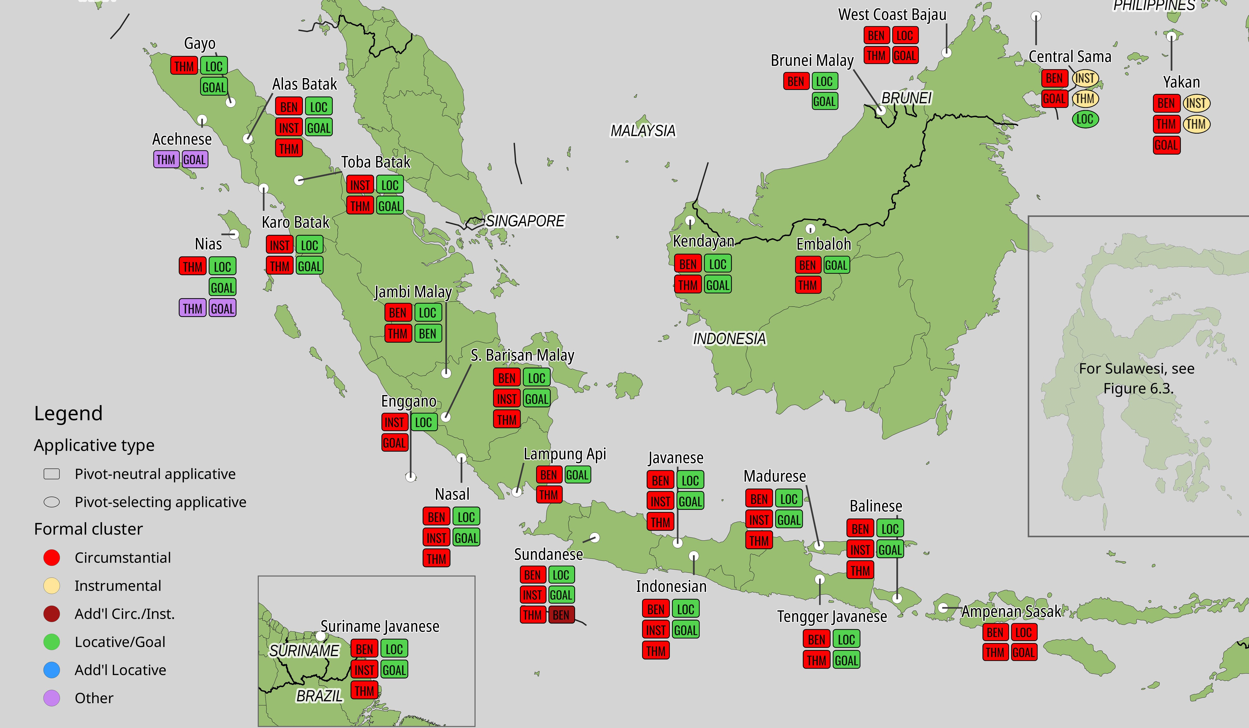
Preliminaries Distribution Forms & functions Wrap-up References
Extra slides
Applicative systems in West Nusantara
Map 4: Pivot-neutral and mixed applicative systems of West Nusantara
Notes:
If we look at how semantic roles for the applied argument, the peripheral role coded as core, distributed across forms,
We observe a stable and pervasive pattern of two forms, one marking selection of beneficiaries, instruments and themes (RED), and one marking locations and goals (GREEN)

Slide 14
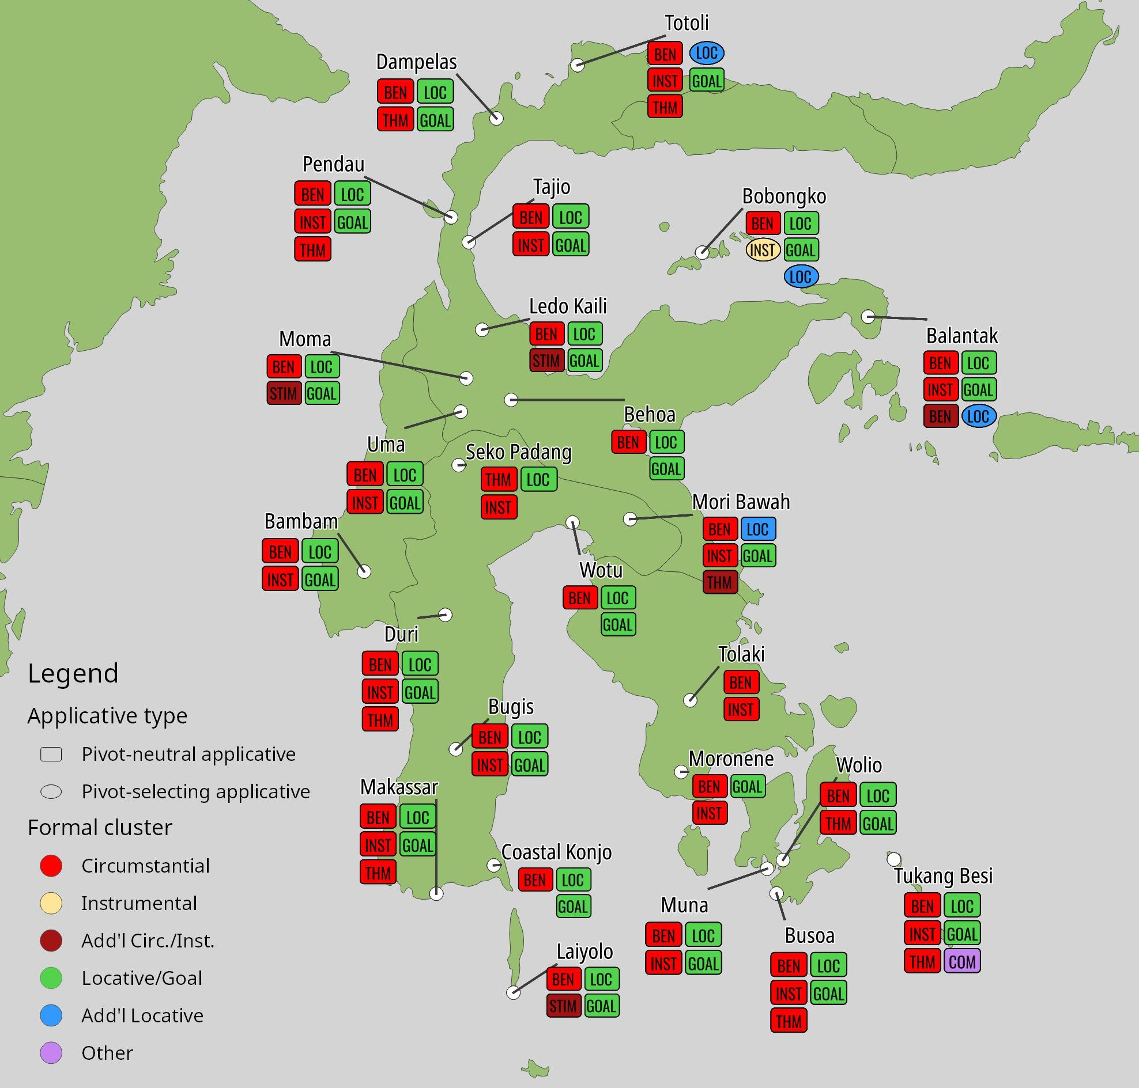
Preliminaries Distribution Forms & functions Wrap-up References
Extra slides
Applicative systems in West Nusantara
Map 5: Pivot-neutral and mixed applicative systems of Sulawesi

Slide 15
Preliminaries
Distribution
Forms & functions
Wrap-up
References
Extra slides
Findings
Predominant pattern: one form of AM for locative and goal ACs, and one for benefactive, instrumental, and theme-selecting ACs.
Typologically unusual, trend is for locatives & instrumentals to share form, not benefactives and instrumentals (Peterson 2007).
But reconstructed for PAn and PMP.
Remnant constructions show TAM conditioned alternations of -i and -an for locative/goal applicatives, as seen in PAn, PMP.
Interpretation: Locative/goal AMs mark constructions derived from earlier LV (PMP *-i imp.,*-an indic.)
For benefactive/instrumental AMs, older form is -AN type, newer forms are -K and
-AK type (see Sirk 1996).
Interpretation: Benefactive/instrumental AMs mark those derived from earlier CV (PMP *-an imp., *Si- indic.), sometimes with replacement forms.

Slide 16
Preliminaries
Distribution
Forms & functions
Wrap-up
References
Extra slides
PAn voice morphology
Table: Proto-Austronesian voice morphology (Chen 2017: 151)
Mood
Actor Voice Patient Voice Locative Voice Circumstantial Voice
Indicative | *<um> | *-ən | *-an | *Si-/*Sa-
Optative, hortative | *-a | *-aw | *-ay | *-anay
Imperative, negative | *-∅ | *-u | *-i | *-an

Slide 17
Preliminaries
Distribution
Forms & functions
Wrap-up
References
Extra slides
TAM-conditioned remnant alternations for locative/goal AMs
Table: Morphological marking for locative applicatives and TAM in selected languages
PAn (LV) Std. Javanese Totoli Toba Batak Bobongko
Indic., neutral
*-an
Indicative
AV N- -i
PV -i
Nonrealis
mo(g)-/moN- -i
-i
Indicative
mang-/mar-/ma- -i
∅-/di- -i
Unrealized mon- -i ku-/o- -i
Indic., perf.
*-in- -an
PV, archaic
AV (no form)
PV (no data)
Realis
no(g)-/noN- -i ni- -an
Compl. participial
-um- -i ni- -an
Realized
non- -i
-in- -an
Imper./Neg. *-i ^{AV} | Imper./Irr. (no form) -an-a | Imperative (no data) (no data) | Imperative (no form) -i | Imperative pon- -i -i
Opt./Hort. *-ay ^{AV} | Propositive N- -i | Promissory (no form)
PV | -an-é | -an
PV
Sources: Oglobin 2005; Himmelmann & Riesberg 2013; Nababan 1981; Mead 2001
Notes:
The most prevalent AM forms in these languages is the suffix –i (originally only for imperatives and negative clauses)
But remnants in perfective categories, shown marking with suffix –an, specifically in PV perfective, when the location/goal is the pivot, parallel to earlier LV.
-i affix has been extended into indicative mood, especially in AV categories, which are innovative compared to earlier LV. (LV does not combine with AV in Philippine-type languages, but this type of locative applicative does).

Slide 18
Preliminaries
Distribution
Forms & functions
Wrap-up
References
Extra slides
Distribution of benefactive/instrumentals
-AN type suﬀixes have broad geographic and genetic distribution
Found in South Sulawesi (incl. Badaic), Tolitoli, Malayic, Sama-Bajau, Bali-Sasak-Sumbawa, possibly others.
-K and -AK forms are newer, sometimes clear replacements
Found in Sumatran (e.g. Batak, Barrier Islands, Gayo, Enggano, Nasal), Celebic (excl. Tolitoli, Badaic), Malayic, Javanese, Sundanese, Madurese.
    But sound correspondences are frequently problematic
In Malayic -kan or -ka known to have replaced applicative *-an (Adelaar 1992).
Javanese -aken and -aké cannot be reconstructed to Proto-Javanese (Adelaar 2011).
Replacement patterns may be complex
  Std. Jav. -akən replaced Old Jav. *-(ʔ)ən, itself a possible merger of PMP PV *-ən and CV *-an.
Muna -ghoo, but fused AMs -angko 2sg, -ane 3sg, -anda 3pl (van den Berg 2013), suggesting < PMP CV imperative *-an
Notes:
Unexplained loss of final /n/, loss of initial vowel, and some problematic consonants. Muna –ghoo (voice uvular fricative) < PMP *q not *k

Slide 19
Preliminaries
Distribution
Forms & functions
Wrap-up
References
Extra slides
Muna pronominal suﬀixes
Table: Muna pronominal suﬀixes for direct and indirect objects
 | Direct object | Indirect object
1sg | -kanau | -kanau
2sg | -ko | -angko
2sg.pol | -kaeta | -kaeta
3.sg | -e | -ane
1du.incl | — | —
1pl.incl | — | —
1pl.excl | -kasami | -kasami
2pl | -ko-omu | -angko-omu
2pl.pol | -kaeta-amu | -kaeta-amu
3pl | -da | -anda
Source: van den Berg 2013

Slide 20
Preliminaries
Distribution
Forms & functions
Wrap-up
References
Extra slides
Takeaways
Philippine-type LV & CV constructions and “Indonesian-type” pivot-neutral applicatives are related historically, functionally, typologically.
But the latter are not associated with any coherent “Indonesian-type” profile with specific settings for voice, alignment, case marking, word order, etc.
They are simply associated with breakdown of the Philippine-type voice system.
The distribution of applicative functions to forms in West Nusantara is best explained by inheritance (in large part).
However, for benefactive/instrumental applicative markers, the forms themselves may have undergone replacement, with newer forms being of the -K and -AK shapes.
Older forms are likely inherited, from PMP CV imperative *-an and LV imperative *-i or indicative *-an.

Slide 21

Preliminaries
Distribution
Forms & functions
Wrap-up
References
Extra slides
Acknowledgments
Hatur Nuhun, Terima Kasih, Mahalo Nui
Special thanks to
Dewi Setiani and Eti
Wawan Sahrozi and Johan Safri
Khairunnisa
Hendi Feriza
The Bilinski Educational Foundation for funding supporting this research.

Slide 22
Preliminaries
Distribution
Forms & functions
Wrap-up
References
Extra slides
References I
Adelaar, K. Alexander. 1992. Proto Malayic: The reconstruction of its phonology and parts of its lexicon and morphology. (Pacific Linguistics C 119). Canberra: Pacific Linguistics and Australia National University. 253 pp.
Adelaar, K. Alexander. 2011. Javanese -aké and -akən: A short history. Oceanic Linguistics 50(2). 338–350.
Artawa, Ketut. 1998. Ergativity and Balinese Syntax: Part I. NUSA: Linguistic Studies of Indonesian and Other Languages in Indonesia (42).
Breiman, Leo. 2001. Random forests. Machine Learning 45. 5–32. https://link-springer-
com.eres.library.manoa.hawaii.edu/content/pdf/10.1023/A:1010933404324.pdf (13 April, 2023).
Chen, Victoria. 2017. A reexamination of the Philippine-type voice system and its implications for Austronesian primary-level subgrouping. Honolulu: University of Hawai i at Mānoa dissertation.
Clayre, Beatrice. 1996. The changing face of focus in the languages of Borneo. Pacific Linguistics. Series A.
Occasional Papers 84. 51–88.
Connell, Timothy M. 2013. A sketch grammar of Matéq: A Land Dayak language of West Kalimantan.
University of Canterbury Master’s thesis.
Conners, Thomas J. 2008. Tengger Javanese. New Haven, CT: Yale University dissertation.
Dillon, John A. 1994. A grammatical description of Tatana’. Ann Arbor: University of Michigan Master’s thesis. ix 155.
Hammarström, Harald, Robert Forkel, Martin Haspelmath & Sebastian Bank (eds.). 2022. Glottolog 4.7.
Leipzig: Max Planck Institute for Evolutionary Anthropology. https://doi.org/10.5281/zenodo.7398962.

Slide 23
Preliminaries
Distribution
Forms & functions
Wrap-up
References
Extra slides
References II
Haspelmath, Martin. 2010. Comparative concepts and descriptive categories in crosslinguistic studies. Language
86(3). 663–687.
Himmelmann, Nikolaus P. 2005. The Austronesian languages of Asia and Madagascar: Typological characteristics. In K. Alexander Adelaar & Nikolaus P. Himmelmann (eds.), The Austronesian languages of Asia and Madagascar (Routledge Family Language Series), 110–181. New York: Routledge.
Himmelmann, Nikolaus P. & Sonja Riesberg. 2013. Symmetrical voice and applicative alternations: Evidence
from Totoli. Oceanic Linguistics 52(2). 396–422. http:
//muse.jhu.edu/content/crossref/journals/oceanic_linguistics/v052/52.2.himmelmann.html
(7 April, 2021).
Mead, David. 2001. A preliminary sketch of the Bobongko language. NUSA: Linguistic Studies of Indonesian and Other Languages 49. 61–94.
Nababan, P. W. J. 1981. A grammar of Toba-Batak. (Pacific Linguistics 37). Canberra, A.C.T: Research School
of Pacific Studies, Australian National University. 146 pp.
Nguyen, Tam Thi Minh. 2013. A grammar of Bih. Eugene, OR: University of Oregon dissertation. 373 pp. Oglobin, Alexander K. 2005. Javanese. In K. Alexander Adelaar & Nikolaus P. Himmelmann (eds.), The
Austronesian languages of Asia and Madagascar. New York: Routledge.
Peterson, David A. 2007. Applicative constructions. (Oxford Studies in Typology and Linguistic Theory).
Oxford: Oxford University Press. 293 pp.

Slide 24
Preliminaries
Distribution
Forms & functions
Wrap-up
References
Extra slides
References III
Ross, Malcolm. 2009. Proto Austronesian verbal morphology: A reappraisal. In K. Alexander Adelaar &
Andrew Pawley (eds.), Austronesian historical linguistics and culture history: A festschrift for Robert Blust, 295–326. Canberra: Pacific Linguistics.
Sirk, Ülo. 1996. On the history of transitive verb suﬀixes in the languages of western Indonesia. In
Hein Steinhauer (ed.), Papers in Austronesian linguistics, no. 3 (Pacific Linguistics A 84), 191–205. Canberra: Pacific Linguistics.
Tadmor, Uri. 1995. Language contact and systemic restructuring: The Malay dialect of Nonthaburi, central
Thailand. Honolulu, HI: University of Hawai’i at Mānoa dissertation. 382 pp.
Truong, Christina L. 2024. Western Austronesian applicative constructions: Typological and functional approaches. Honolulu, HI: University of Hawai’i at Mānoa dissertation.
van den Berg, René. 2013. A grammar of the Muna language. (SIL E-Books 52). Dallas, TX: SIL International.
https://www.sil.org/resources/archives/52170 (22 February, 2022).

Slide 25
Preliminaries
Distribution
Forms & functions
Wrap-up
References
Extra slides
Javanese benefactive/instrumental applicatives
Table: Benefactive/instrumental applicatives and TAM in Javanese
PAn (PV) PAn (CV) Std. Javanese Tengger Jav.
Indic., neutral
*-ən
Indic., neutral
*Si-/Sa-
Indicative
AV N- -aké
PV ∅-/di- -aké
Indicative
N- -ən
∅-/di- -ən
Indic., perf.
*-in- -
Indic., perf.
*-in- -an
PV, archaic
PV -in- -aké
PV, archaic (no data)
Non-volitional
PV ka- -aké
Non-volitional
kə- -∅
Imper./Neg.
stem
Imper./Neg.
*-an(-i)
Imper./Irr.
AV N- -n-a
PV -n-a
Imper./Irr.
N- -ən
-na
Opt./Hort.
*-a
Opt./Hort.
*-an-ay
Propositive
AV N- -aké
PV -n-é
Propositive
N- -na
(no form)
Sources: Chen 2017; Ross 2009: 306; Oglobin 2005; Conners 2008.
25 / 27

Slide 26
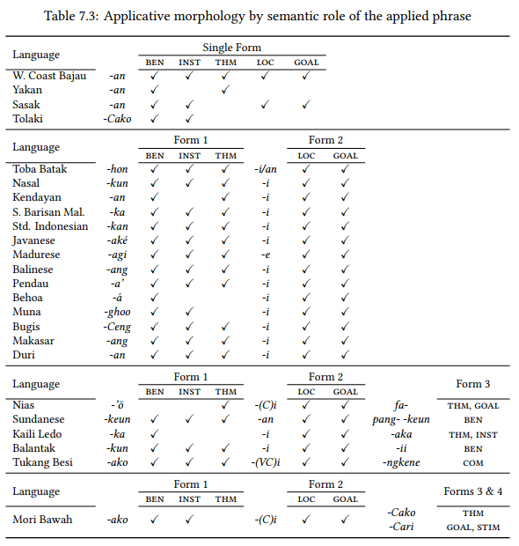
Table: Applicative morphology by semantic role of the applied phrase (selected languages)

Slide 27
Preliminaries
Distribution
Forms & functions
Wrap-up
References
Extra slides
Analytic benefactive constructions
(5) Bih, Periphrastic benefactive construction with ‘give’
Thô gơ magĭr ngă ana năn
T. 3 pfx.try make crossbow dist
ngă leh ngă ana rĭ răm,
make pfv make crossbow whittle arrow
dua tlâo urăt, brei kơ ñu.
two three cl ben dat 3
‘Thô tried to make a crossbow and some arrows for him.’
(6) Nonthaburi Malay, Periphrastic benefactive construction with ‘give’
(Nguyen 2013: 90)
mɔʔ bli tpoŋ bi an makiŋ
mother buy snack give child eat
‘The mother bought snacks for her children.’
(Tadmor 1995: 261)

Slide 28
Preliminaries
Distribution
Forms & functions
Wrap-up
References
Extra slides
Analytic PV constructions
Matéq, Analytic PV
  pingàt aiq yoh ni koq moruh
plate that prt pv 1sg av.smash
‘I smashed the plate’
b. ni ular aiq degeq
nyora ruba turuaq=ng
pv snake that constantly av.attack hole dibbling.stick=3
‘the snake kept on attacking their dibbling holes’
(Connell 2013: 113)
(8) Sa’ban, Periphrastic PV with ‘make’
Ayeu noknai an ieh m-paeng.
tree this make 3sg av-cut.down
‘He will cut down this tree.’
(Clayre 1996: 78)

Slide 29
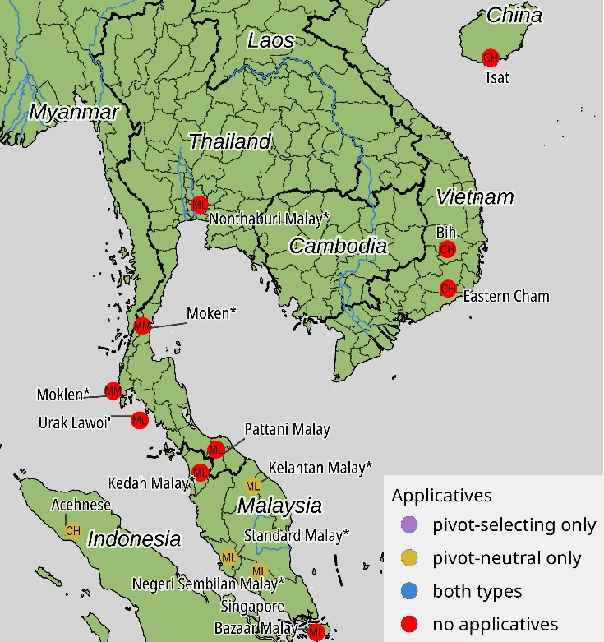
Map 6: Distribution of applicatives in Mainland SE Asia & Peninsular Malaysia

Slide 30
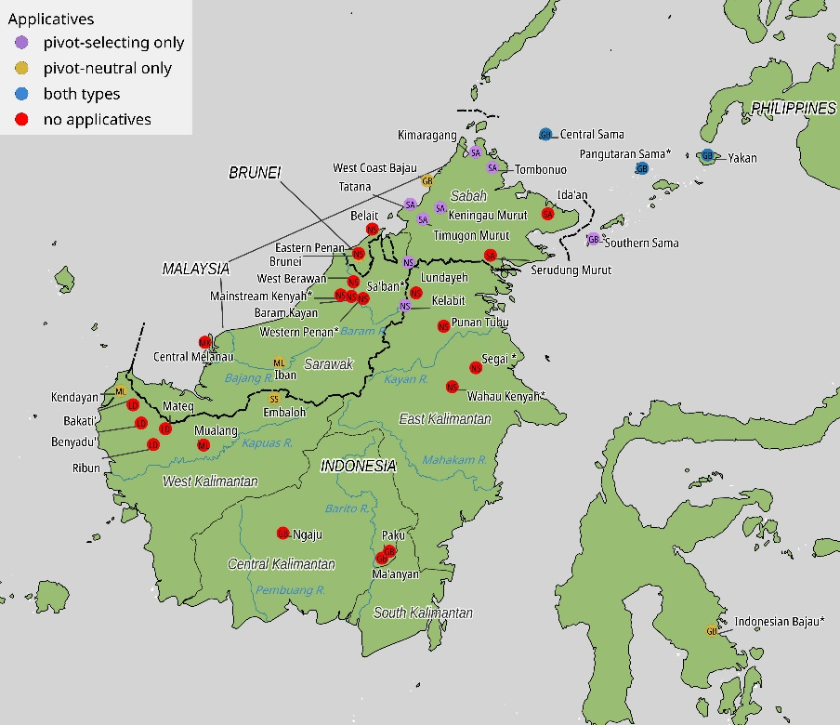
Map 7: Distribution of applicatives in Borneo

Slide 31
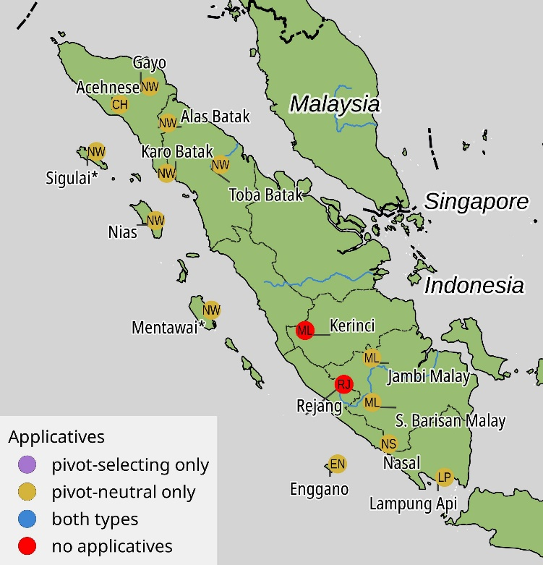
Map 8: Distribution of applicatives in Sumatra & the Barrier Islands

Slide 32
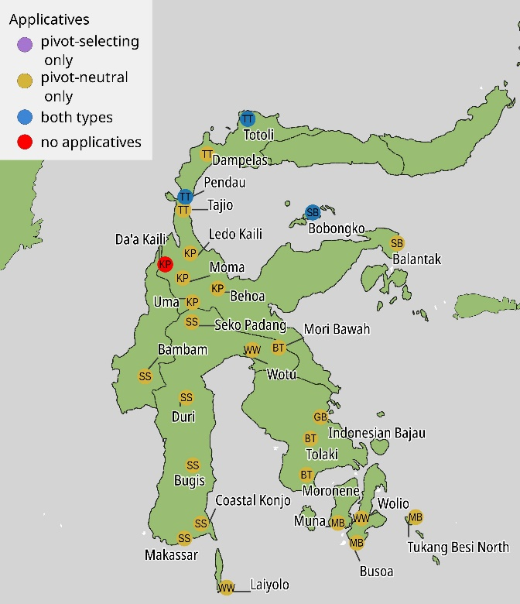
Map 9: Distribution of applicatives in Sulawesi

